Slide 1
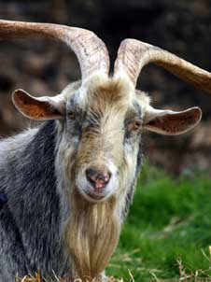
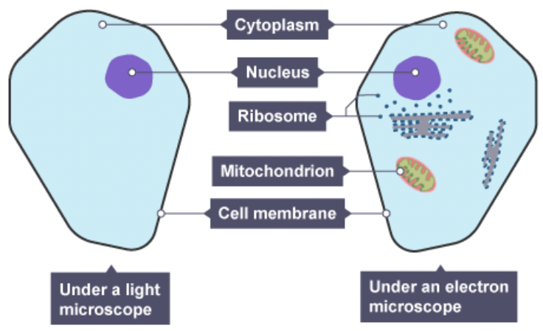
Animal kingdom
The Animal kingdom is the best known kingdom.
The organisms in this kingdom are very diverse and includes a range of organisms from sponges, to jellyfish, to insects and humans.
Animals have certain characteristics that set them apart from other living things (organisms).
•They are multicellular.
•Get their nutrition from feeding on other organisms (heterotrophic).
•They are capable of movement from one place to another.
•They have nervous coordination.
•They have no cell wall or chloroplasts and therefore do not photosynthesise.
•Store carbohydrate as glycogen.

Slide 2
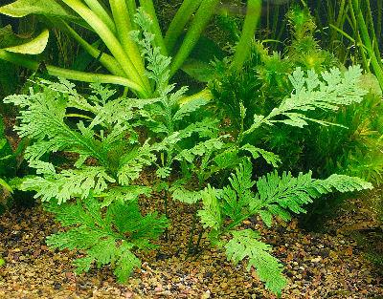
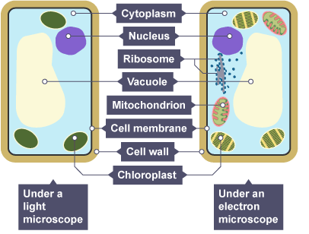
Plant kingdom
Plants are living organisms belonging to the plant kingdom.
They include familiar organisms such as trees, flowers, herbs, bushes, grasses, vines, ferns and mosses.
The scientific study of plants is known as botany.
•They are multicellular.
•Cells contain chloroplasts.
•Carry out photosynthesis and therefore make their own food (autotrophic). For photosynthesis to happen plants need light energy which is trapped by chloroplasts which are found in their cells.
•Have cellulose cell walls.
•Store sugar as starch or sucrose.

Slide 3
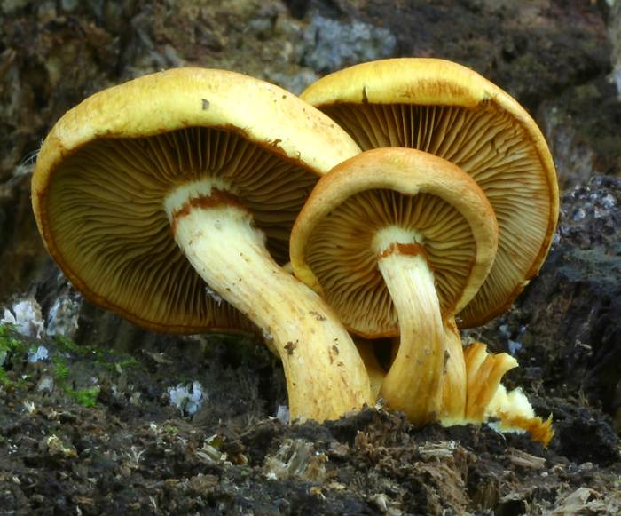
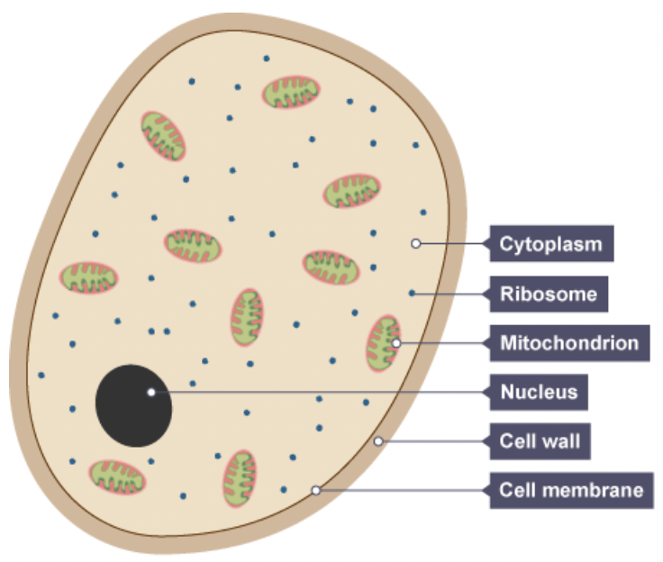
Fungi kingdom
Fungi come in all shapes and sizes.
The simplest fungi are moulds that grow on rotting food (bread mould).
The fungi kingdom also contains mushrooms, yeasts and toadstools.
Fungi have similar characteristics to plants and are sometimes mistakenly put in the plant kingdom.
•Can be multicellular or unicellular.
•Cell wall made of chitin.
•Made of a network of fibres called a mycelium of hyphae which have many nuclei.
•Fungi get the energy they need by digesting other plants and animals. They feed by saprophytic nutrition using extracellular enzymes (outside the cell).
•Store carbohydrate as glycogen.

Slide 4
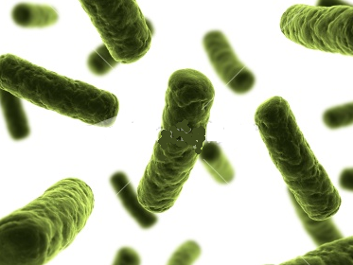
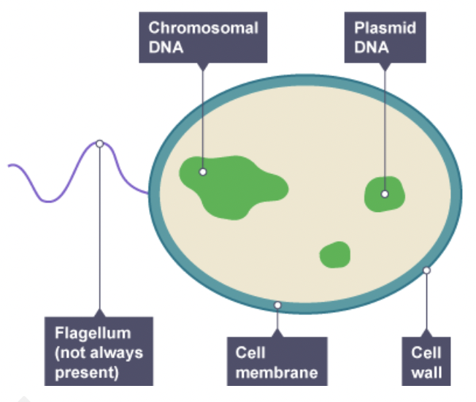
Bacteria kingdom
The bacteria kingdom contains the largest number of organisms.
Bacteria are microscopic and they have a wide range of shapes, ranging from spheres to rods and spirals.
Bacteria kingdom includes a range of bacteria (Eg – E.coli and MRSA).
•Small single celled organisms.
•Cell wall made of peptidoglycan.
•Some have a capsule or slime layer.
•Has no nucleus (prokaryotic).
•Some species have flagella for movement.
•Some contain plasmids (small loops of DNA).
•Have one circular chromosome.
•Some can do photosynthesis.

Slide 5
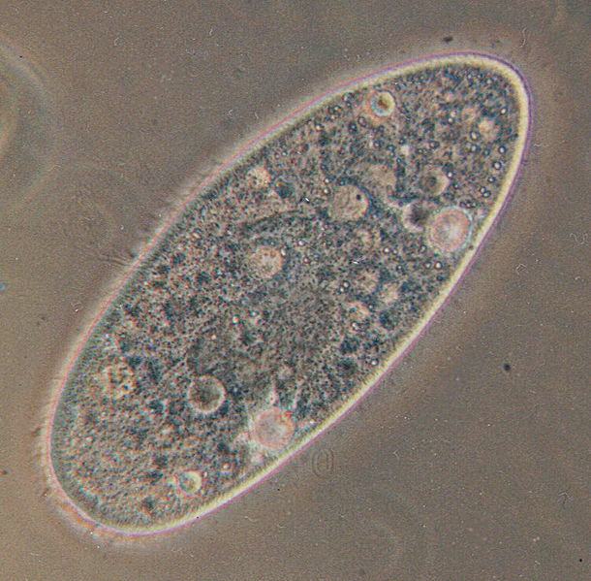
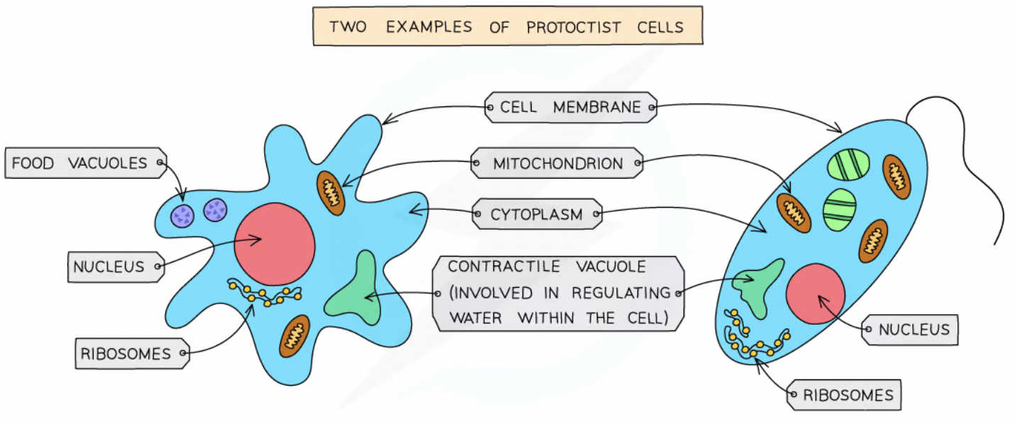
Protoctist kingdom
The Protoctistan’s are a diverse group and contain organisms that do not fit into any other group. They are sometimes referred to as the ‘junk draw’ of organisms.
The protoctistan’s do not have much in common besides a relatively simple organisation. They have a wide variety of size, structure and form.
Protoctists include the amoeba and the paramecium.
Protoctistan’s are unicellular organisms – this means they are made up of only one cell.
Protoctistan’s have a very simple cell structure and are different to bacteria cells as they DO contain a nucleus.

